Slide 1
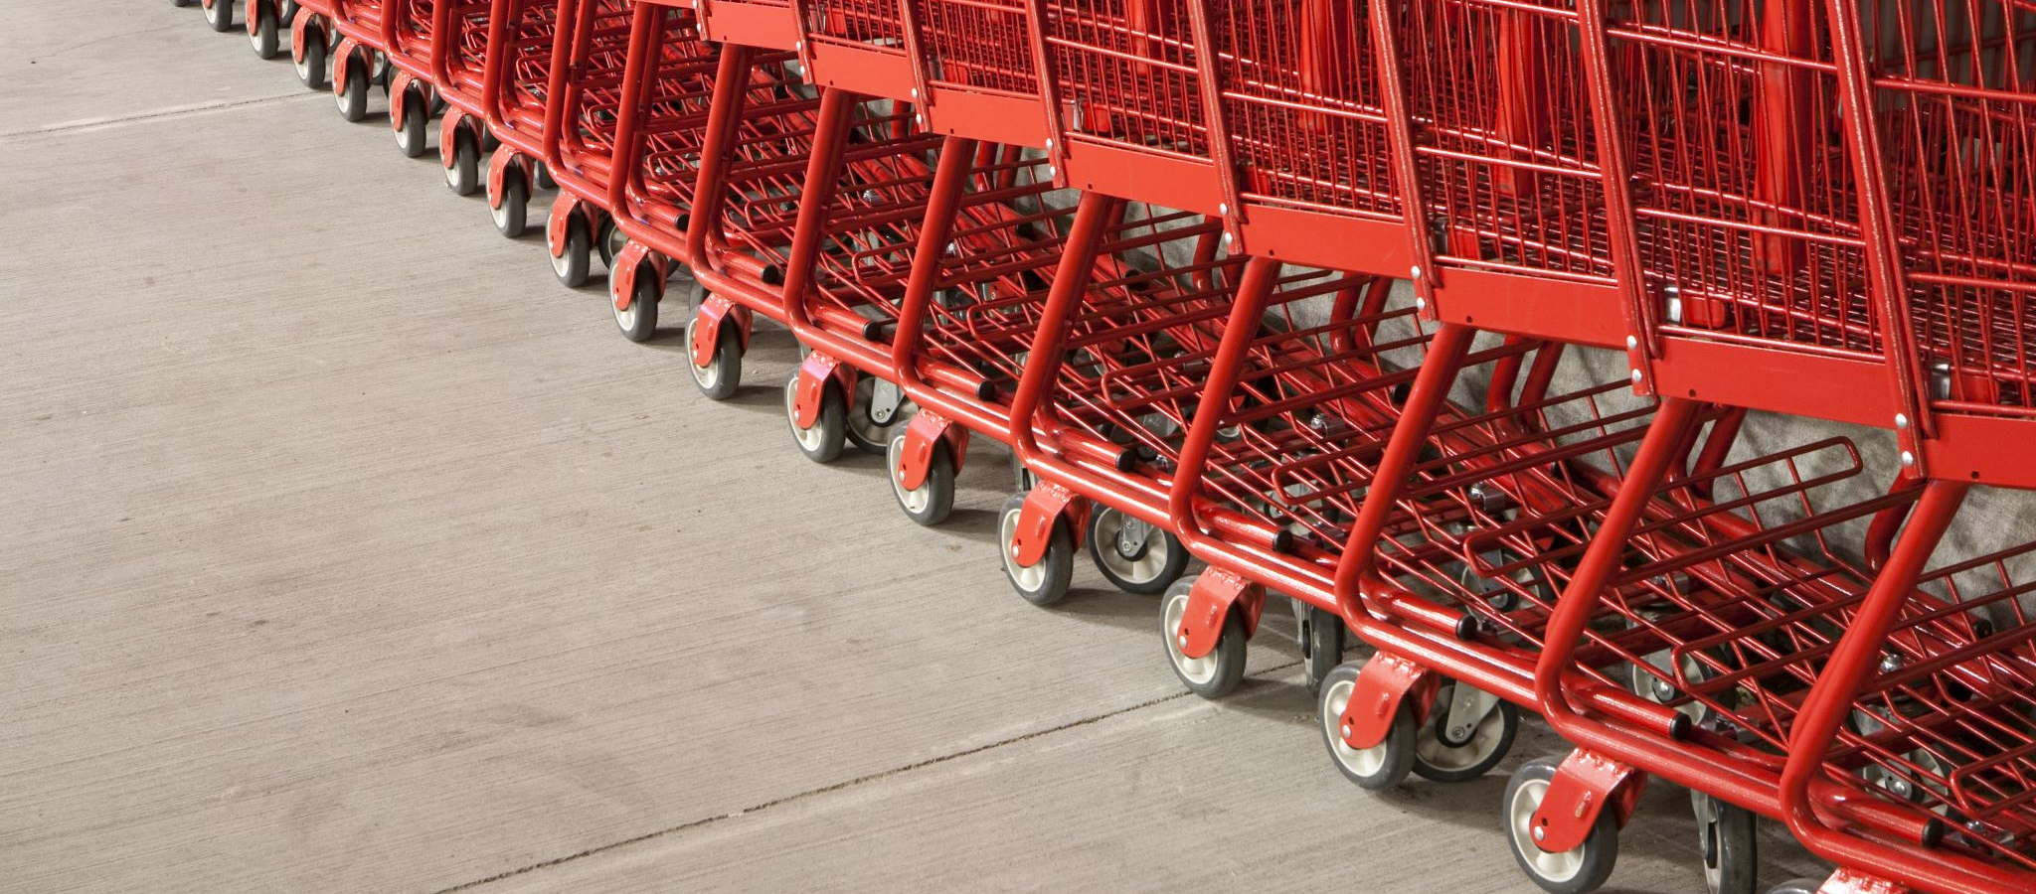
E-commerce Business Models and Concepts

Slide 2
Tweet Tweet: Twitter’s Business Model
What characteristics or benchmarks can be used to assess the business value of a company such as Twitter?
Have you used Twitter to communicate with friends or family? What are your thoughts on this service?
What are Twitter’s most important assets?
Which of the various methods described for monetizing Twitter’s assets do you feel might be most successful?

Slide 3
E-commerce Business Models
Business model
Set of planned activities designed to result in a profit in a marketplace
Business plan
Describes a firm’s business model
E-commerce business model
Uses/leverages unique qualities of Internet and Web

Slide 4
Eight Key Elements of a Business Model
Value proposition
Revenue model
Market opportunity
Competitive environment
Competitive advantage
Market strategy
Organizational development
Management team

Slide 5
1. Value Proposition
“Why should the customer buy from you?”
Successful e-commerce value propositions:
Personalization/customization
Reduction of product search, price discovery costs
Facilitation of transactions by managing product delivery

Slide 6
2. Revenue Model
“How will you earn money?”
Major types of revenue models:
Advertising revenue model
Subscription revenue model
Transaction fee revenue model
Sales revenue model
Affiliate revenue model

Slide 7
3. Market Opportunity
“What marketspace do you intend to serve and what is its size?”
Marketspace: Area of actual or potential commercial value in which company intends to operate
Realistic market opportunity: Defined by revenue potential in each market niche in which company hopes to compete
Market opportunity typically divided into smaller niches

Slide 8
4. Competitive Environment
“Who else occupies your intended marketspace?”
Other companies selling similar products in the same marketspace
Includes both direct and indirect competitors
Influenced by:
Number and size of active competitors
Each competitor’s market share
Competitors’ profitability
Competitors’ pricing

Slide 9
5. Competitive Advantage
“What special advantages does your firm bring to the marketspace?”
Is your product superior to or cheaper to produce than your competitors’?
Important concepts:
Asymmetries
First-mover advantage, complementary resources
Unfair competitive advantage
Leverage
Perfect markets

Slide 10
6. Market Strategy
“How do you plan to promote your products or services to attract your target audience?”
Details how a company intends to enter market and attract customers
Best business concepts will fail if not properly marketed to potential customers

Slide 11
7. Organizational Development
“What types of organizational structures within the firm are necessary to carry out the business plan?”
Describes how firm will organize work
Typically, divided into functional departments
As company grows, hiring moves from generalists to specialists

Slide 12
8. Management Team
“What kind of backgrounds should the company’s leaders have?”
A strong management team:
Can make the business model work
Can give credibility to outside investors
Has market-specific knowledge
Has experience in implementing business plans

Slide 13
Raising Capital
Seed capital
Traditional sources
Incubators
Commercial banks
Angel investors
Venture capital firms
Strategic partners
Crowdfunding
JOBS Act

Slide 14
Crowdfunding Takes Off
What types of projects and companies might be able to most successfully use crowdfunding?
Are there any negative aspects to crowdfunding?
What obstacles are presented in the use of crowdfunding as a method to fund start-ups?

Slide 15
Categorizing E-commerce Business Models
No one correct way
Text categorizes according to:
E-commerce sector (e.g., B2B)
E-commerce technology (e.g., m-commerce)
Similar business models appear in more than one sector
Some companies use multiple business models (e.g., eBay)

Slide 16
B2C Business Models
E-tailer
Community provider (social network)
Content provider
Portal
Transaction broker
Market creator
Service provider

Slide 17
B2C Models: E-tailer
Online version of traditional retailer
Revenue model: Sales
Variations:
Virtual merchant
Bricks-and-clicks
Catalog merchant
Manufacturer-direct
Low barriers to entry

Slide 18
B2C Models: Community Provider
Provide online environment (social network) where people with similar interests can transact, share content, and communicate
Examples: Facebook, LinkedIn, Twitter, Pinterest
Revenue models:
Typically, hybrid, combining advertising, subscriptions, sales, transaction fees, and so on

Slide 19
B2C Models: Content Provider
Digital content on the Web:
News, music, video, text, artwork
Revenue models:
Subscription; pay per download (micropayment); advertising; affiliate referral
Variations:
Syndication
Web aggregators

Slide 20
B2C Business Models: Portal
Search plus an integrated package of content and services
Revenue models:
Advertising, referral fees, transaction fees, subscriptions
Variations:
Horizontal/general
Vertical/specialized (vortal)
Search

Slide 21
B2C Models: Transaction Broker
Process online transactions for consumers
Primary value proposition—saving time and money
Revenue model:
Transaction fees
Industries using this model:
Financial services
Travel services
Job placement services

Slide 22
B2C Models: Market Creator
Create digital environment where buyers and sellers can meet and transact
Examples:
Priceline
eBay
Revenue model: Transaction fees, fees to merchants for access

Slide 23
B2C Models: Service Provider
Online services
Example: Google—Google Maps, Gmail, and so on
Value proposition
Valuable, convenient, time-saving, low-cost alternatives to traditional service providers
Revenue models:
Sales of services, subscription fees, advertising, sales of marketing data

Slide 24
B2B Business Models
Net marketplaces
E-distributor
E-procurement
Exchange
Industry consortium
Private industrial network

Slide 25
B2B Models: E-distributor
Version of retail and wholesale store, MRO goods, and indirect goods
Owned by one company seeking to serve many customers
Revenue model: Sales of goods
Example: Grainger.com

Slide 26
B2B Models: E-procurement
Creates digital markets where participants transact for indirect goods
B2B service providers, application service providers (ASPs)
Revenue model:
Service fees, supply-chain management, fulfillment services
Example: Ariba

Slide 27
B2B Models: Exchanges
Independently owned vertical digital marketplace for direct inputs
Revenue model: Transaction, commission fees
Create powerful competition between suppliers
Tend to force suppliers into powerful price competition; number of exchanges has dropped dramatically

Slide 28
B2B Models: Industry Consortia
Industry-owned vertical digital marketplace open to select suppliers
More successful than exchanges
Sponsored by powerful industry players
Strengthen traditional purchasing behavior
Revenue model: Transaction, commission fees
Example: Exostar

Slide 29
Private Industrial Networks
Digital network used to coordinate among firms engaged in business together
Typically evolve out of company’s internal enterprise system
Example: Walmart’s network for suppliers
Cost absorbed by network owner and recovered through production and distribution efficiencies

Slide 30
E-commerce Enablers: The Gold Rush Model
E-commerce infrastructure companies have profited the most:
Hardware, software, networking, security
E-commerce software systems, payment systems
Media solutions, performance enhancement
CRM software
Databases
Hosting services, and so on

Slide 31
How E-commerce Changes Business
E-commerce changes industry structure by changing:
Rivalry among existing competitors
Barriers to entry
Threat of new substitute products
Strength of suppliers
Bargaining power of buyers

Slide 32
Industry Value Chains
Set of activities performed by suppliers, manufacturers, transporters, distributors, and retailers that transform raw inputs into final products and services
Internet reduces cost of information and other transactional costs
Leads to greater operational efficiencies, lowering cost, prices, adding value for customers

Slide 33
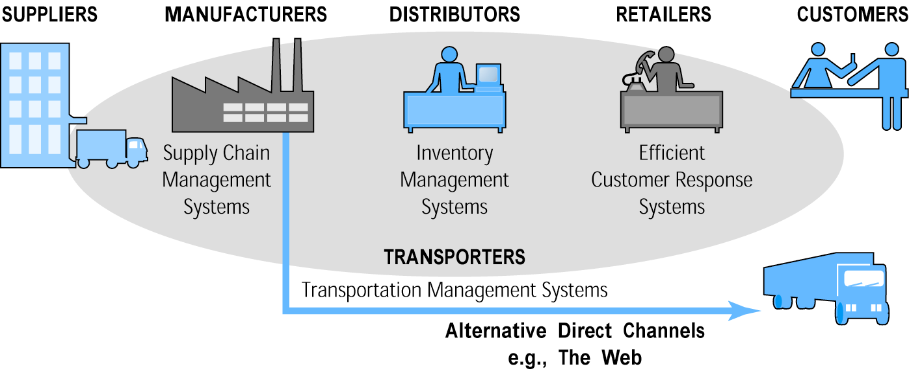
E-commerce and Industry Value Chains

Slide 34
Firm Value Chains
Activities that a firm engages in to create final products from raw inputs
Each step adds value
Effect of Internet:
Increases operational efficiency
Enables product differentiation
Enables precise coordination of steps in chain

Slide 35
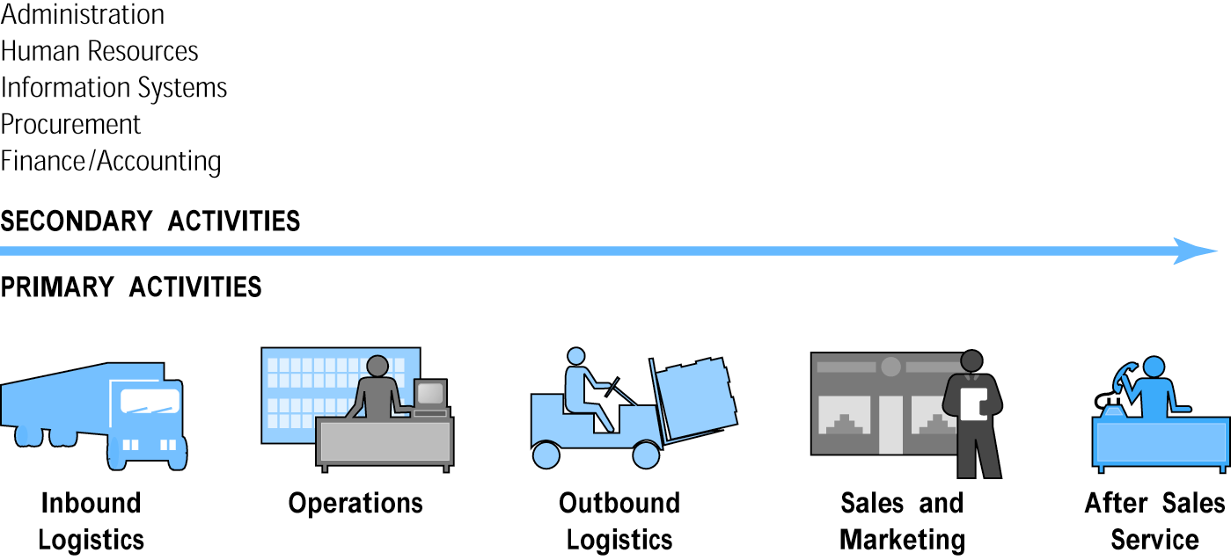
E-commerce and Firm Value Chains

Slide 36
Firm Value Webs
Networked business ecosystem
Uses Internet technology to coordinate the value chains of business partners
Coordinates a firm’s suppliers with its own production needs using an Internet-based supply chain management system

Slide 37
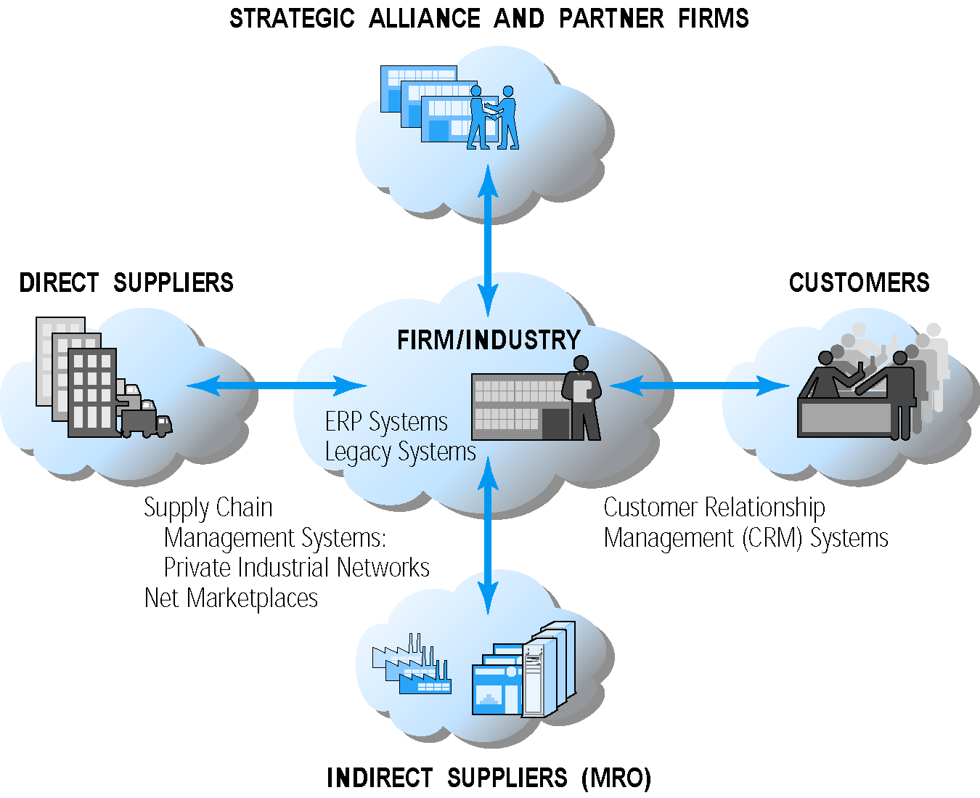
Internet-enabled Value Web

Slide 38
Business Strategy
Plan for achieving superior long-term returns on capital invested: that is, profit
Five generic strategies
Product/service differentiation
Cost competition
Scope
Focus
Customer intimacy

